Slide 1

Azharuddin H Mohammad
Christopher James
Kiran Reddy Kancharla
Jiaxing Liu

Slide 2




Online Bookstore
Introduction
Team organization
Process model
plan
System Design
Functionalities
UML diagrams
Demo
Test Report
Deployment Issues
Future Aspects
References

Slide 3
Online Bookstore
Ordering books.
Display information
Create and process orders
Cart management
User management
Users
Customers
Employees/Administrators

Slide 4
Team Organization
Leader/Designer -- Jiaxing
Developer/Presenter -- Christopher
Developer/Testing -- Azharuddin
Documentation/Testing -- Kiran Reddy

Slide 5
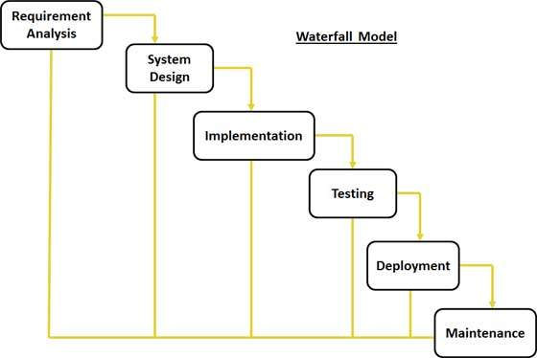
Process model
Waterfall Process Model
Small Project
No uncertain requirements

Slide 6

Plan
Requirements – (9/27/16 – 10/11/16)
Plan – (10/12/16 – 10/20/16)
Development/Implementation – (10/21/16 – 11/8/16)
Testing – (11/9/16 – 11/21/16)
Deployment/Manual/Presentation – (11/22/16 – 12/6/16)

Slide 7
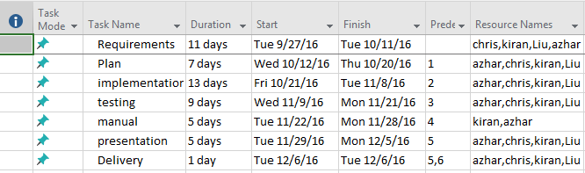
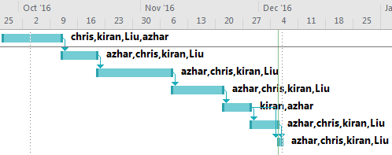
Plan

Slide 8
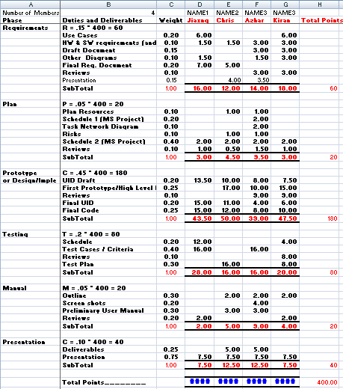

Slide 9

System Design
Development Server
512 MB of Memory
20 GB of Storage
Ubuntu 16.04 LTS (Xenial Xerus)
Apache 2
MySQL
PHP 7.0.4
CRUD API
Production Server?

Slide 10
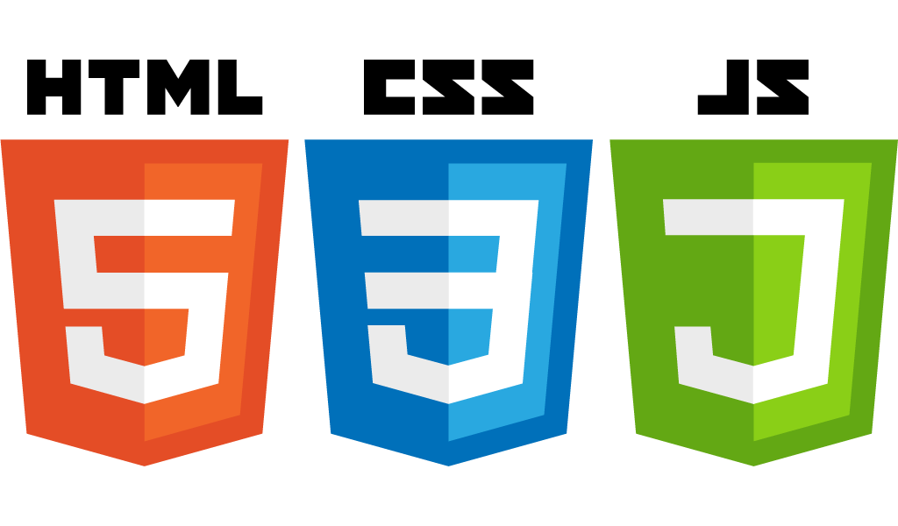
Software Design
Languages
PHP
HTML
JavaScript
SQL
CSS
Frameworks/Libraries
jQuery
cURL
Bootstrap

Slide 11
Functionalities
Login Screen
Register Screen
Book Overview screen
Checkout – Cart screen
Payment confirmation

Slide 12
Interface Design

Slide 13
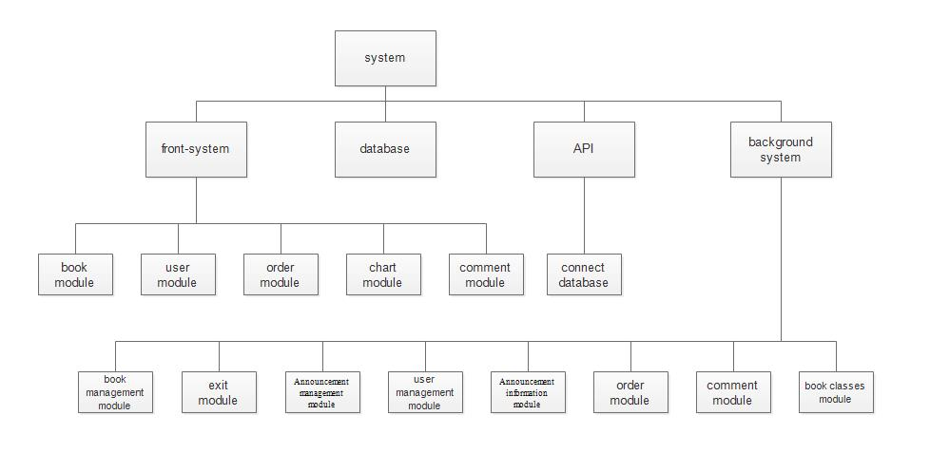

Slide 14
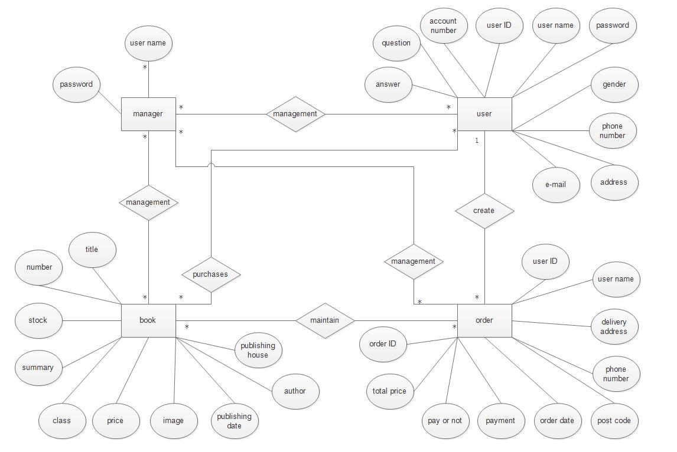

Slide 15
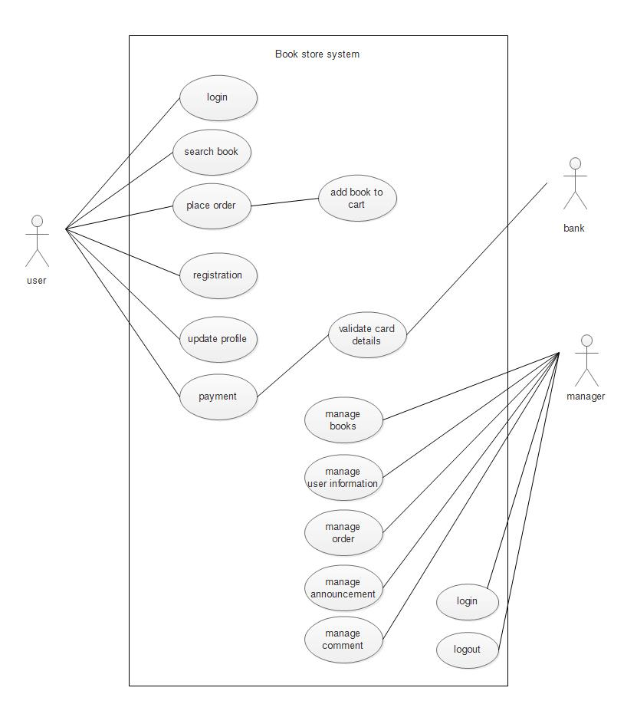
Usecase

Slide 16
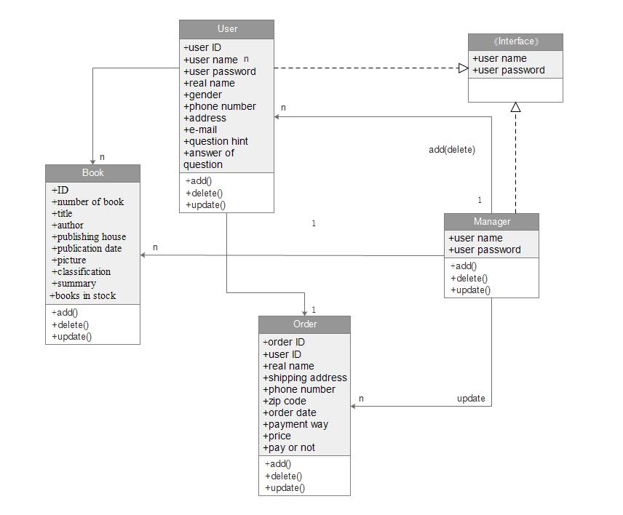

Slide 17
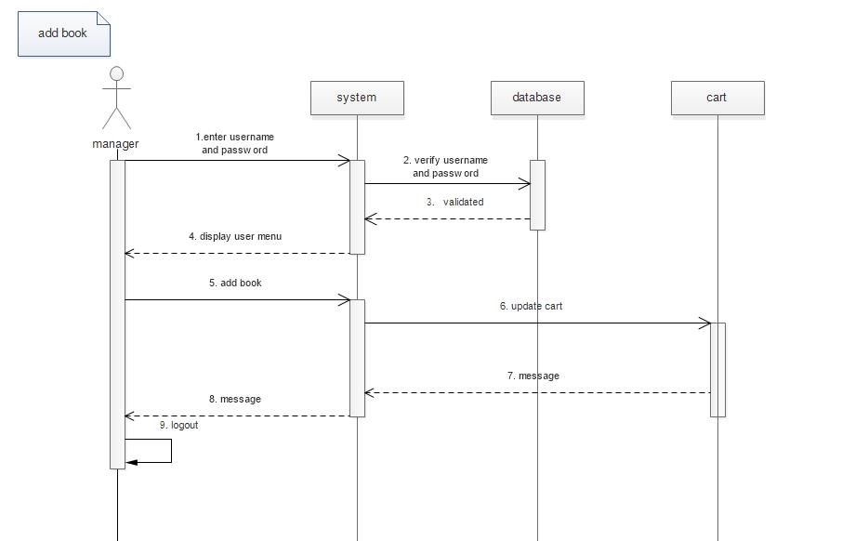
Sequence – add book

Slide 18
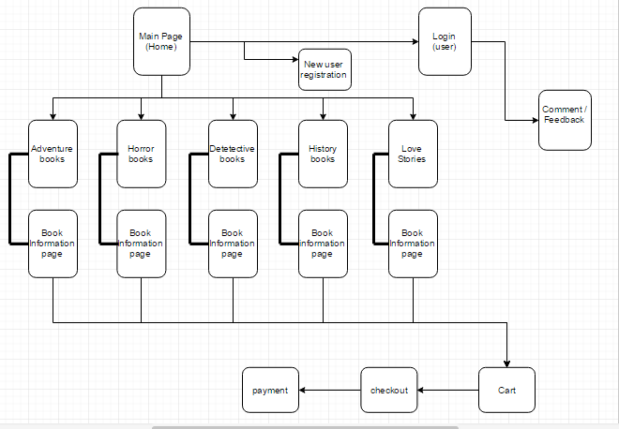
Navigation Diagram

Slide 19
Demo

Slide 20
Test Report
White Box Techniques
Unit Testing
Statement Coverage
Branch Coverage
Path Coverage
Black Box Techniques
Interface Testing
System Testing
Usability Testing

Slide 21
Deployment Issues
Server Configuration
Temperamental
Asynchronous JavaScript needed to run in a particular order sometimes.
Error correction is difficult and tedious.

Slide 22
If We Had More Time
Stripe
Template the web pages
Use of the database and/or cookies over session
More fine tuning of CSS
Improved data validation
Efficient database requests
Search Bar

Slide 23
What We Learned
Web design is difficult
JavaScript is really versatile
Websites are difficult to debug
Asynchronous requests makes programming difficult

Slide 24
References
[1] How to install a LAMP stack on Ubuntu. https://www.digitalocean.com/community/tutorials/how-to-install-linux-apache-mysql-php-lamp-stack-on-ubuntu
[2] Ubuntu 16.04 LTS - Xenial Xerus. https://wiki.ubuntu.com/XenialXerus/ReleaseNotes
[3]. Sommerville I., Software Engineering 10th edition, Delhi, Pearson Education, Ltd, 2015.
[4]. Pressman Roger S., Software Engineering – A Practitioner’s Approach 7th edition, New York, McGraw-Hill, 2010.

Slide 25

Questions?

Slide 26
“Developing the future together.”

